Slide 1
Extending Ktor for Server Side Development
Ido Flax
Github: Flaxoos
Kotlin Slack: Ido Flax
Notes:
Hello everyone. My name is Ido Flax, i’m a backend engineer and open source entrepreneur. I’m the developer of the extra ktor plugins library
In this talk we are going to talk about using ktor for server side development
We are going to discuss what are the advantages and disadvantages of adopting it
We are going show how we can achieve with it the same capabilities that we expect from a BE server framework
We are going to set up an example system and utilize existing plugins for BE development
And we will learn how we can easily do it ourselves (and should :)

Slide 2

Who is using Ktor?
Client?
Server?
Plugins?
Notes:
Let me begin by asking, Who here uses Ktor?
Who’s using it for client/FE ?
Who’s using it for server/BE ?

Slide 3
Why Ktor?
Lightweight and minimalistic 🚀
Explicit and clear configuration 🛠️
Native Coroutines
Fully Kotlin-centric
Quick start and iteration 🔌
Low resource consumption 🌱
Notes:
Lightweight and minimalistic:
Ktor offers a streamlined and minimal framework, providing just the essential components you need. This approach results in smaller deployment sizes and significantly quicker application startup times compared to heavier frameworks.
Explicit and clear configuration:
With Ktor, there’s no hidden magic or automatic configuration happening behind the scenes. You explicitly install each plugin or feature you require. This ensures complete clarity about your application’s setup and behavior.
Coroutines and asynchronous processing:
Ktor natively supports Kotlin’s coroutines, allowing efficient, asynchronous, non-blocking operations. This feature makes it especially suitable for applications that need high concurrency, excellent performance, and scalability.
Fully Kotlin-centric:
Designed specifically with Kotlin developers in mind, Ktor leverages idiomatic Kotlin APIs and DSLs, making your code clear, concise, and expressive. It also seamlessly integrates with Kotlin-specific technologies, like serialization libraries and multiplatform capabilities.
Flexible plugin architecture:
Ktor uses a flexible and powerful plugin system that allows developers to easily extend functionality. You can add exactly the features your project needs, creating custom plugins as necessary, which ensures you never have unnecessary bloat.
Quick start and iteration:
Because of its lightweight nature and straightforward setup, Ktor enables rapid prototyping, testing, and deployment. This helps your development team iterate quickly, from initial idea to production-ready service in minimal time.
Low resource consumption:
Due to its small footprint, Ktor is ideal for resource-constrained environments like cloud deployments or microservices architectures. Its low memory usage and rapid startup time mean you can deploy more efficiently and cost-effectively at scale.

Slide 4
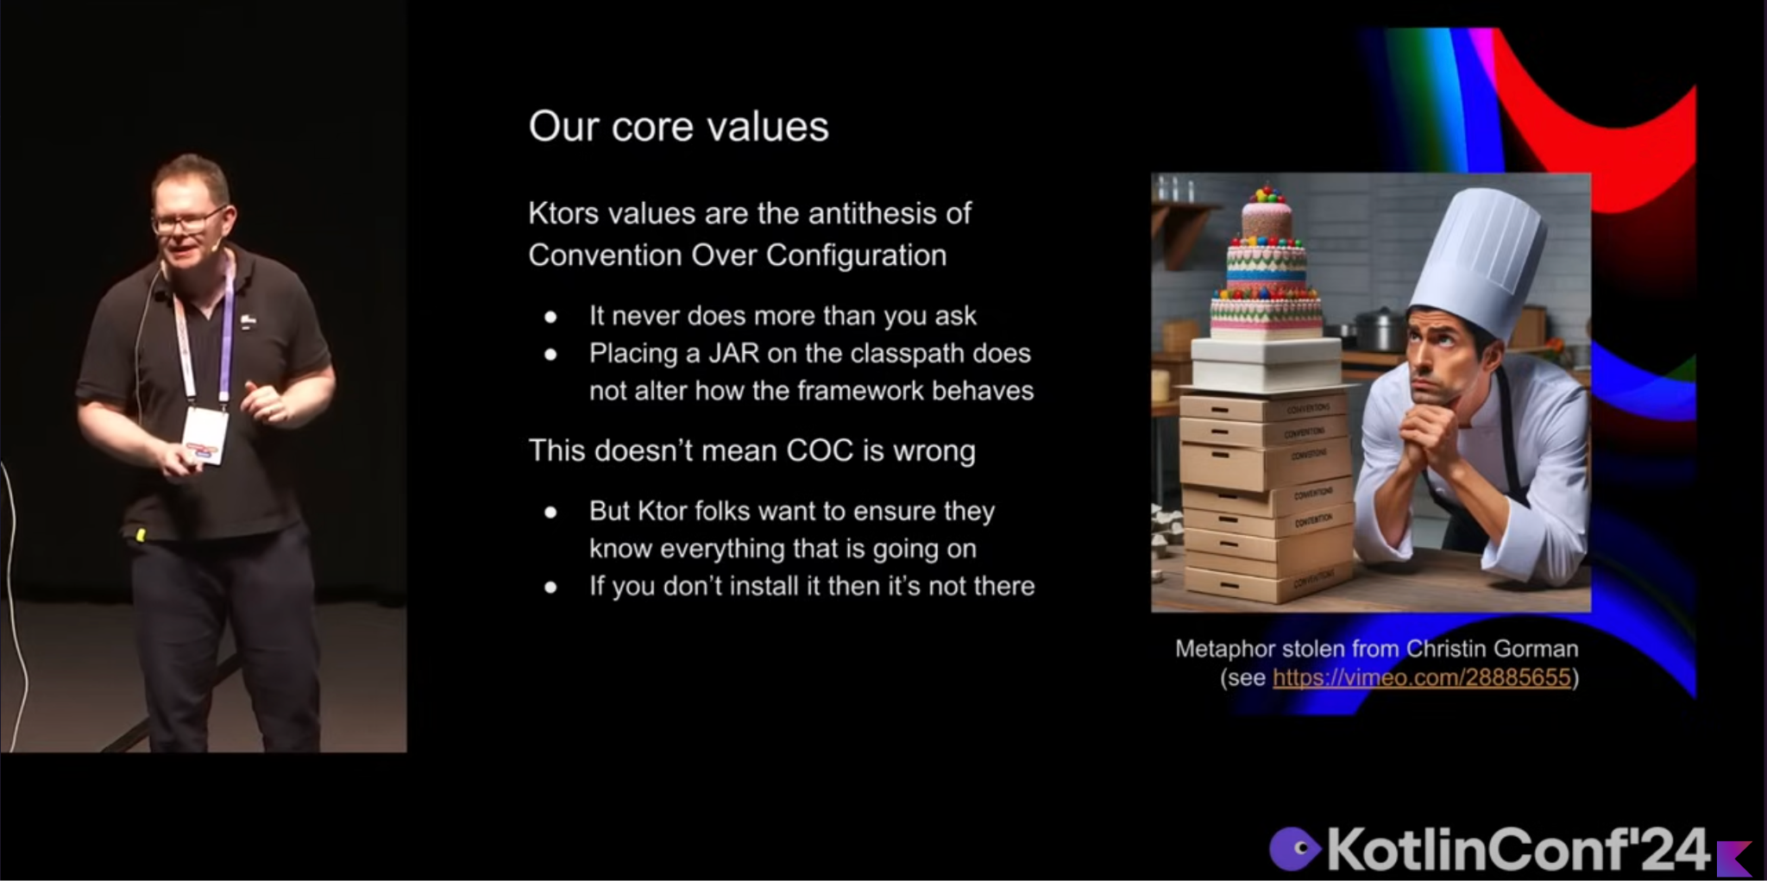
Ktor’s Values
Notes:
So What are ktor’s values?
I’m just going to delegate it to Garth Gilmour who said it best last year in this very conference

Slide 5
The Current State of Affairs
>80% Kotlin BE devs use spring-boot
~9% Use ktor-server
138 starters in intellij spring wizard
67 plugins in intellij ktor wizard
Maturity
Notes:
It seems that although kotlin as a language is widely very loved (as it should be) among BE devs and teams, most of them still opt for using java based frameworks for backend development, mostly Spring boot <>
Ktor is trending, but it’s still in a minority, and mostly be early adopters
A big Part of this is mostly because of sheer number of spring boot starters, covering all your dev needs
I just did this manual count myself, by looking at the project wizards in intellij, and the number seems to be half as much for Ktor, but i’m sure digging into it the number would be even lower
And a just as important aspect is the maturity of these starters / plugins. For spring they have been around for several years / decades (?)
For ktor, we’re talking 2-3 maybe 4 years max

Slide 6
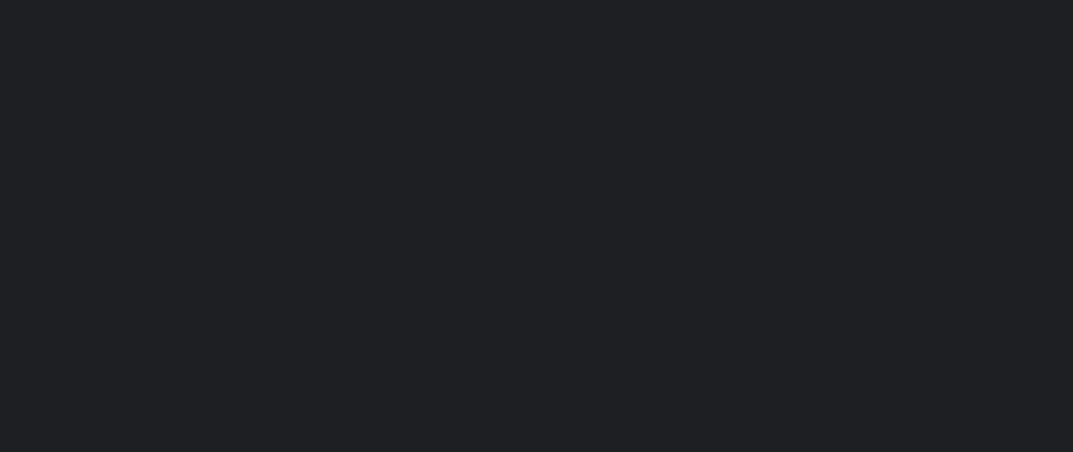
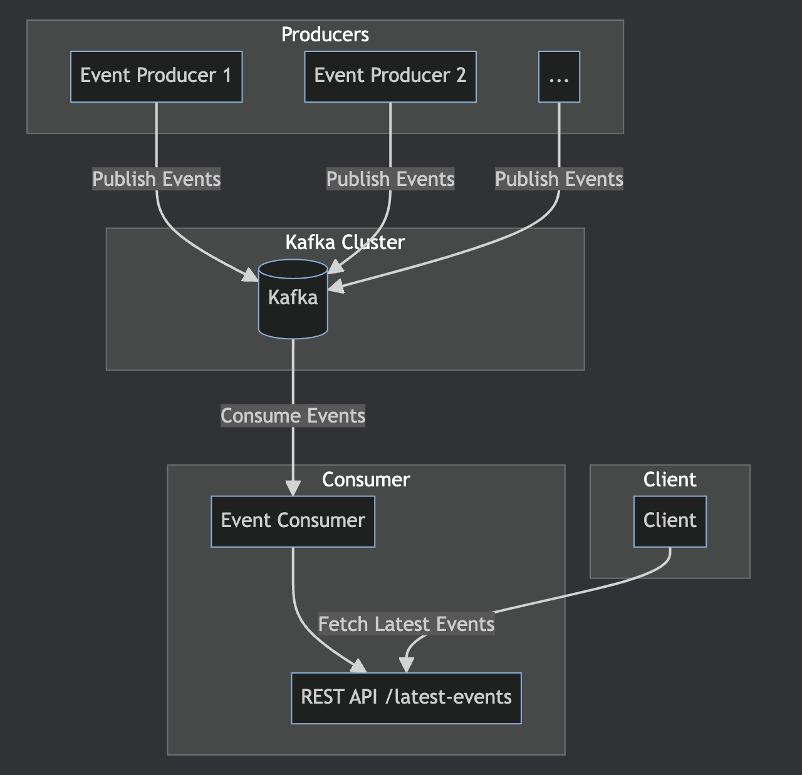
Our system
Notes:
So as i said before, We’re going to have a little demonstration of how we would go about using ktor for setting up a BE system
We’ll have an event producer, that will have 1..n instances
It will publish events to kafka
We’ll have a consumer that will subscribe to those events, and store them in memory, exposing an endpoint to fetch those events
And finally a client that will query those events

Slide 7
Producing events
fun main() = embeddedServer(CIO, PRODUCER_PORT, "0.0.0.0", module = Application::module).start()
fun Application.module() {}
fun Application.sendEvent() {
val id = environment.config.property("ktor.application.id").getString()
val event = MyEvent(message = "Hello from producer $id")
log.info("Sending event: ${event.message}")
}
fun Application.launchEventJob() {
launch {
while (isActive) {
this@launchEventJob.sendEvent()
delay(1.seconds)
}
}
}
fun Application.produceEvents() {
monitor.subscribe(ApplicationStarted) { application ->
application.log.info("Event Producer Started")
application.launchEventJob()
}
}
Notes:
So let’s define out producer server
We start with a main function for our server, that loads an appliction module <CLICK>
We define a function for sending an event, using the application id. for now, we’ll stub it by logging the event <CLICK>
We define a function that will launch a job to call that function every second <CLICK>
Now, how do we make it so we launch the job when we start the application? <CLICK>
Ktor gives us access to application events, that we can subscribe to. In this case, we want the application started event <CLICK>

Slide 8
Producing events
fun main() = embeddedServer(CIO, PRODUCER_PORT, "0.0.0.0", module = Application::module).start()
fun Application.module() { produceEvents() }
fun Application.sendEvent() {
val id = environment.config.property("ktor.application.id").getString()
val event = MyEvent(message = "Hello from producer $id")
log.info("Sending event: ${event.message}")
}
fun Application.launchEventJob() {
launch {
while (isActive) {
this@launchEventJob.sendEvent()
delay(1.seconds)
}
}
}
fun Application.produceEvents() {
monitor.subscribe(ApplicationStarted) { application ->
application.log.info("Event Producer Started")
application.launchEventJob()
}
}
Notes:
So we register that function on our module, and we’re good to go
But what are the problems with that?
1. 🔗 Coupling and Lack of Encapsulation
When subscribing directly to events using the monitor object:
• The event-handling logic is tightly coupled to your application’s setup, making it hard to reuse or move between projects.
• You end up scattering subscriptions throughout your application code, leading to maintenance headaches.
2. 🧩 Poor Modularity
Direct event subscriptions:
• Don’t inherently group related functionality together clearly.
• Make it challenging to understand or document how certain features or behaviors relate to your application.
3. ⚙️ No Clear Configuration Mechanism
With monitor subscriptions:
• There’s no built-in mechanism for flexible, customizable configurations.
• Adjustments often require changes to the subscription logic itself, causing potential duplication or complexity.
4. 📖 Less Explicit Intent and Readability
• Direct subscriptions are less explicit, making the application’s intent unclear to new developers or external contributors.
• Understanding which parts of the code handle events can become increasingly difficult as the application scales.
So let’s talk about how we can do the same with a ktor application plugin

Slide 9
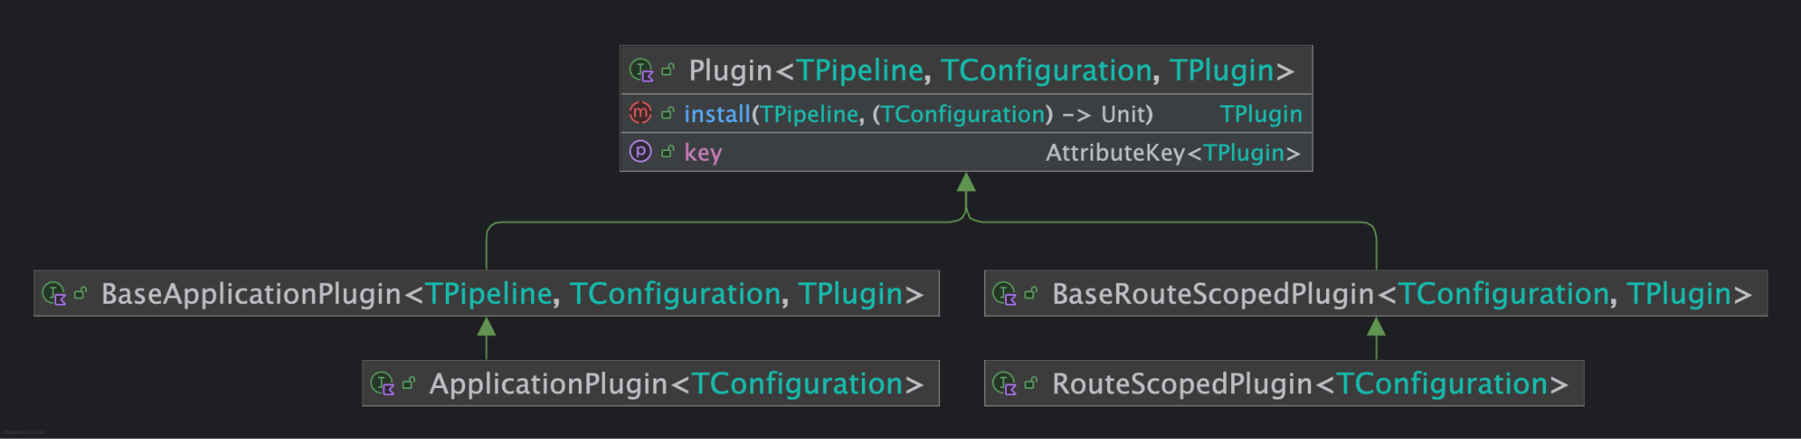
Ktor Plugin API
Notes:
So let’s talk about the ktor plugin API:
The plugin interface has two sub types:
BaseApplication Plugin
BaseRouteScopedPlugin
The plugin interface has three type parameters:
TPlugin which can be any type defined by the developer, should they wish to so, in which case, they will implement the BaseApplication/RouteScopedPlugin, however that is the pre Ktor v2, way of doing things, and now in most cases,
Pipeline same as above
But the simplified API way of doing things is to use the simplified interfaces:
ApplicationPlugin
RouteScopedPlugin
So the developer only needs to create a configuration class (or even do without one)

Slide 10
Creating a Plugin
public fun createApplicationPlugin(
name: String,
body: PluginBuilder<Unit>.() -> Unit
): ApplicationPlugin<Unit> = createApplicationPlugin(name, {}, body)
----
val produceEventsPlugin =
createApplicationPlugin("produceEvents") {
on(MonitoringEvent(ApplicationStarted)) { application ->
application.log.info("Event Producer Started")
application.launchEventJob()
}
}
Notes:
Ktor gives us functions for creating plugins, either application plugins, or route scoped plugins <>
In this case we create an application plugin <>
The function accepts a plugin name, that would be used as it’s key, and an init block, operating oin the plugin builder with a Unit type param <>
So we create a plugin that does the same as our function from before, where we monitor the applicaiton started event, and lunch the event job <>

Slide 11
Installing a Plugin
public fun createApplicationPlugin(
name: String,
body: PluginBuilder<Unit>.() -> Unit
): ApplicationPlugin<Unit> = createApplicationPlugin(name, {}, body)
----
val produceEventsPlugin =
createApplicationPlugin("produceEvents") {
on(MonitoringEvent(ApplicationStarted)) { application ->
application.log.info("Event Producer Started")
application.launchEventJob()
}
}
fun Application.produceEvents() {
install(produceEventsPlugin)
}
Notes:
As shown before, the plugin interface has an install function. The wider plugin API gives us extension functions for the relevant pipelines that instll the plugin to it <>
So here we call application.install( plugin) <>

Slide 12
Application with Installed Plugin
fun main() = embeddedServer(CIO, PRODUCER_PORT, "0.0.0.0", module = Application::module).start()
fun Application.module() { produceEvents() }
fun Application.sendEvent() {
val id = environment.config.property("ktor.application.id").getString()
val event = MyEvent(message = "Hello from producer $id")
log.info("Sending event: ${event.message}")
}
fun Application.launchEventJob() {
launch {
while (isActive) {
this@launchEventJob.sendEvent()
delay(1.seconds)
}
}
}
fun Application.produceEvents() {
install(produceEventsPlugin)
}
val produceEventsPlugin =
createApplicationPlugin("produceEvents") {...}
Notes:
And we put that function in our module <>
Ok, so, not very impressive now is it?
But notice we hard coded the frequency of our event emission.
We should probably do better then that right? <>

Slide 13
Plugin Configuration
public fun <PluginConfigT : Any> createApplicationPlugin(
name: String,
createConfiguration: () -> PluginConfigT,
body: PluginBuilder<PluginConfigT>.() -> Unit
): ApplicationPlugin<PluginConfigT> = ApplicationPluginImpl(name, { createConfiguration() }, body)
---
class ProduceEventsConfig(
var frequency: Duration = 1.seconds
)
val produceEventsPlugin =
createApplicationPlugin("produceEvents", ::ProduceEventsConfig) {
on(MonitoringEvent(ApplicationStarted)) { application ->
application.log.info("Event Producer Started")
application.launchEventJob()
}
}
Notes:
So now we create an application plugin using the variation of the function that accepts a configuration initializer
We define a configuration class for our plugins, which can be `out Any`. <>
It’s best practice to use vars for the configuration classes, and depending on the use case, also provide default values, as this would have an effect on how installing them looks like <>

Slide 14
Installing a Configurable Plugin
public fun <PluginConfigT : Any> createApplicationPlugin(
name: String,
createConfiguration: () -> PluginConfigT,
body: PluginBuilder<PluginConfigT>.() -> Unit
): ApplicationPlugin<PluginConfigT> = ApplicationPluginImpl(name, { createConfiguration() }, body)
---
class ProduceEventsConfig(
var frequency: Duration = 1.seconds
)
val produceEventsPlugin =
createApplicationPlugin("produceEvents", ::ProduceEventsConfig) {
on(MonitoringEvent(ApplicationStarted)) { application ->
application.log.info("Event Producer Started")
application.launchEventJob()
}
}
fun Application.produceEvents() {
install(produceEventsPlugin){ frequency = 1.seconds }
}
Notes:
And now when we install the plugin we can configure it in the configure block of our install function.

Slide 15
Installing a Configurable Plugin
public fun <PluginConfigT : Any> createApplicationPlugin(
name: String,
createConfiguration: () -> PluginConfigT,
body: PluginBuilder<PluginConfigT>.() -> Unit
): ApplicationPlugin<PluginConfigT> = ApplicationPluginImpl(name, { createConfiguration() }, body)
---
class ProduceEventsConfig(
var frequency: Duration = 1.seconds
)
val produceEventsPlugin =
createApplicationPlugin("produceEvents", ::ProduceEventsConfig) {
on(MonitoringEvent(ApplicationStarted)) { application ->
application.log.info("Event Producer Started")
application.launchEventJob()
}
}
fun Application.produceEvents() {
install(produceEventsPlugin){
frequency = application.environment.config.property("frequency").getString().toInt().seconds
}
Notes:
And it’s even better if we take that from out application configuration

Slide 16
Installing a Configurable Plugin
fun main() = embeddedServer(CIO, PRODUCER_PORT, "0.0.0.0", module = Application::module).start()
fun Application.module() { produceEvents() }
fun Application.sendEvent() {
val id = environment.config.property("ktor.application.id").getString()
val event = MyEvent(message = "Hello from producer $id")
log.info("Sending event: ${event.message}")
}
fun Application.launchEventJob() {
launch {
while (isActive) {
this@launchEventJob.sendEvent()
delay(1.seconds)
}
}
}
fun Application.produceEvents() {
install(produceEventsPlugin){ frequency = application.environment.config... }
}
val produceEventsPlugin = createApplicationPlugin("produceEvents") {...}
Notes:
So now our application looks like this
Ok, better, but to be honest, we could have done all of that without a plugin right? We could have gotten the frequency from the application config in our previous approach, not much has changed.
But, this becomes much more important when we consider scale, encapsulation, intent communication, and more.
Let’s see then how we can use plugins to further support out system

Slide 17
Producing events with kafka
fun Application.configureKafka() {
install(Kafka) {
val events = TopicName.named(TOPIC_NAME)
schemaRegistryUrl = SCHEMA_REGISTRY_URL
topic(events) {
partitions = 1
replicas = 1
}
producer {
bootstrapServers = BOOTSTRAP_SERVERS
retries = 1
clientId = "producer"
}
registerSchemas {
MyEvent::class at events
}
}
}
Notes:
So as of now, we are not doing anything when we send events, we just log them. As stated in out system diagram, we want to publish our events to kafka. So let’s use a nifty little plugin, by your truly, that helps us in doing that
We create a function for configuring kafka
That installs the plugin, and configures it according to our needs

Slide 18
Consuming events with kafka
fun Application.onEvent(event: MyEvent) {
eventStore.add(event)
log.info("Received event: ${event.message}")
}
fun Application.configureKafka() {
install(Kafka) {
val events = TopicName.named(TOPIC_NAME)
schemaRegistryUrl = SCHEMA_REGISTRY_URL
consumer {
bootstrapServers = BOOTSTRAP_SERVERS
groupId = "consumer-group"
clientId = "consumer"
}
consumerConfig {
consumerRecordHandler(events) { record ->
val event = fromRecord<MyEvent>(record.value())
onEvent(event)
}
}
}
}
Notes:
And in our consumer application, create a function to store the events <>
we also install kafka, anb setup the event consumption to call that function <>...
Ok, but as we saw in our system diagram, we’re going to have multiple instances of our producer, and we only want to emit one event at the scheduled time.

Slide 19
Task Scheduling and Coordination
fun Application.configureTasks() {
install(TaskScheduling) {
val redisManagerName = "my-redis-manager"
redis(redisManagerName) {
host = "localhost"
port = 6379
username = "flaxoos"
password = "password"
connectionAcquisitionTimeoutMs = 1000
lockExpirationMs = 4500
}
task(redisManagerName) {
name = "produce-events"
task = {
sendEvent()
}
kronSchedule = {
seconds {
1 every 3
}
}
}
}
}
Notes:
Luckily we also have a plugin for that:
Again, following the same pattern, We create an extension function on the application <>
Here we install the task scheduling plugin. This plugin offers three different flavours of lock management. We’ll use the redis manager <click until config>
And configure it accordingly <click up to next block>
And now we’ll define a task, that uses that manager.
We give it a name
We define the task itself
And a schedule, using under the hood, the lovely Kron library and DSL
Ok so now we have multiple producers, coordinating tasks between them, and a consumer that saves the events <>

Slide 20
Getting Stored Events
fun Application.configureRouting() {
routing {
get("event") {
eventStore.lastOrNull()?.let { call.respond(it) } ?: call.respond(NotFound)
}
}
}
Notes:
The consumer also exposes a get endpoint for getting the events. But what if we want to handle load on our consumer, and maybe define certain quotas for clients based on some criteria?

Slide 21
Rate Limiting
fun Route.configureRateLimiting() {
install(RateLimiting) {
rateLimiter {
type = TokenBucket::class
capacity = 20
rate = 4.seconds
}
}
}
Notes:
We’ll define an extension function on Route <>
And install the rate limiting plugin, which is a route scoped plugin, onto that route <>
And define a rate limiter <>
We’ll use a token bucket <>
And define it’s capacity <>
And rate <>

Slide 22
Rate Limiting
fun Route.configureRateLimiting() {
install(RateLimiting) {
rateLimiter {
type = TokenBucket::class
capacity = 20
rate = 4.seconds
}
}
}
fun Application.configureRouting() {
routing {
configureRateLimiting()
get("event") {
eventStore.lastOrNull()?.let { call.respond(it) } ?: call.respond(NotFound)
}
}
}
Notes:
And now we’ll apply that rate limiter to our route

Slide 23
Client
val scope = CoroutineScope(Dispatchers.IO)
val client = HttpClient(CIO) {}
scope.launch {
while (isActive) {
logger.info("Getting events")
runCatching {
val response =
client.request {
method = Get
url("http://localhost:$CONSUMER_PORT/event")
}
logger.info("Events Response: $response")
}.onFailure {
logger.error("Error: ${it::class.simpleName}: ${it.message}")
}
delay(1.seconds)
}
}
Notes:
Now the last piece of our system is the client that fetches the stored events
Here we have it as part of a main function, where it makes a get request every second
In this case we know that we are going to either get rate limited, or maybe we encounter any other issues, as the server may be down, or who knows.
We want to make this client resilient to any such issues, and we’ll do that by using the circuit breaker pattern

Slide 24
Circuit breaking
fun HttpClientConfig<CIOEngineConfig>.setupCircuitBreaking() {
install(CircuitBreaking) {
global {
failureThreshold = 1
halfOpenFailureThreshold = 5
resetInterval = 1.seconds
}
register("strict".toCircuitBreakerName()) {
failureThreshold = 1
halfOpenFailureThreshold = 1
resetInterval = 5.seconds
}
}
}
Notes:
We’ll define an extension function on the client configuration <>
We’ll install the CircuitBreaking plugin which is a Client Plugin (we are now in the client plugin API which is separate to the server plugin API we looked at before) <>
We can define global behaviour <click until end of block>
And also any specific behaviour, giving it a name <click until end of block>

Slide 25
Resilient Client
val scope = CoroutineScope(Dispatchers.IO)
val client = HttpClient(CIO) {
setupCircuitBreaking()
}
scope.launch {
while (isActive) {
logger.info("Getting events")
runCatching {
val response =
client.requestWithCircuitBreaker(strict) {
method = Get
url("http://localhost:$CONSUMER_PORT/event")
}
logger.info("Events Response: $response")
}.onFailure {
logger.error("Error: ${it::class.simpleName}: ${it.message}")
}
delay(1.seconds)
}
}
Notes:
And now we apply this to out client configuration
And replace the normal request function with the provided requestWithCircuitBreaker function, optionally specifying the specific “strict” behavour we defined before

Slide 26
Our system in action
12:41:06.055 [main] INFO o.a.k.c.p.KafkaProducer - [Producer clientId=producer] Instantiated an idempotent producer.
12:41:06.088 [main] INFO o.a.k.c.p.ProducerConfig - These configurations '[schema.registry.url]' were supplied but are not used yet.
12:41:06.090 [main] INFO o.a.k.c.u.AppInfoParser - Kafka version: 7.7.1-ccs
12:41:06.090 [main] INFO o.a.k.c.u.AppInfoParser - Kafka commitId: 91d86f33092378c8
12:41:06.090 [main] INFO o.a.k.c.u.AppInfoParser - Kafka startTimeMs: 1747910466089
12:41:06.092 [main] INFO 1 - Kafka producer setup finished
12:41:06.092 [main] INFO 1 - Application started in 1.26 seconds.
12:41:06.093 [main] INFO 1 - Application started hook triggered
12:41:06.098 [r-worker-2] INFO 1 - Responding at http://0.0.0.0:8082
12:41:06.348 [| producer] INFO o.a.k.c.Metadata - [Producer clientId=producer] Cluster ID: AQ-YVRs1QqudE24o7XJF-Q
12:41:06.349 [| producer] INFO o.a.k.c.p.i.TransactionManager - [Producer clientId=producer] ProducerId set to 9 with epoch 0
12:41:10.017 [r-worker-6] INFO 1 - Sending event: Hello from producer 1
12:41:25.010 [r-worker-6] INFO 1 - Sending event: Hello from producer 1
12:41:34.007 [r-worker-6] INFO 1 - Sending event: Hello from producer 1
12:41:40.010 [r-worker-3] INFO 1 - Sending event: Hello from producer 1
12:41:52.010 [r-worker-5] INFO 1 - Sending event: Hello from producer 1
12:42:01.009 [r-worker-3] INFO 1 - Sending event: Hello from producer 1
12:42:04.019 [r-worker-3] INFO 1 - Sending event: Hello from producer 1
12:42:13.008 [r-worker-2] INFO 1 - Sending event: Hello from producer 1

Slide 27
Our system in action
12:41:06.805 [main] INFO o.a.k.c.p.KafkaProducer - [Producer clientId=producer] Instantiated an idempotent producer.
12:41:06.831 [main] INFO o.a.k.c.p.ProducerConfig - These configurations '[schema.registry.url]' were supplied but are not used yet.
12:41:06.833 [main] INFO o.a.k.c.u.AppInfoParser - Kafka version: 7.7.1-ccs
12:41:06.833 [main] INFO o.a.k.c.u.AppInfoParser - Kafka commitId: 91d86f33092378c8
12:41:06.833 [main] INFO o.a.k.c.u.AppInfoParser - Kafka startTimeMs: 1747910466832
12:41:06.835 [main] INFO 2 - Kafka producer setup finished
12:41:06.837 [main] INFO 2 - Application started in 0.69 seconds.
12:41:06.837 [main] INFO 2 - Application started hook triggered
12:41:06.842 [r-worker-2] INFO 2 - Responding at http://0.0.0.0:8083
12:41:06.993 [| producer] INFO o.a.k.c.Metadata - [Producer clientId=producer] Cluster ID: AQ-YVRs1QqudE24o7XJF-Q
12:41:06.994 [| producer] INFO o.a.k.c.p.i.TransactionManager - [Producer clientId=producer] ProducerId set to 10 with epoch 0
12:41:07.027 [r-worker-2] INFO 2 - Sending event: Hello from producer 2
12:41:13.010 [r-worker-3] INFO 2 - Sending event: Hello from producer 2
12:41:16.008 [r-worker-3] INFO 2 - Sending event: Hello from producer 2
12:41:19.015 [r-worker-2] INFO 2 - Sending event: Hello from producer 2
12:41:22.012 [r-worker-2] INFO 2 - Sending event: Hello from producer 2
12:41:28.005 [r-worker-7] INFO 2 - Sending event: Hello from producer 2
12:41:31.008 [r-worker-6] INFO 2 - Sending event: Hello from producer 2
12:41:37.007 [r-worker-1] INFO 2 - Sending event: Hello from producer 2

Slide 28
Our system in action
12:41:06.312 [main] INFO o.a.k.c.u.AppInfoParser - Kafka version: 7.7.1-ccs
12:41:06.312 [main] INFO o.a.k.c.u.AppInfoParser - Kafka commitId: 91d86f33092378c8
12:41:06.312 [main] INFO o.a.k.c.u.AppInfoParser - Kafka startTimeMs: 1747910466311
12:41:06.334 [main] INFO i.k.s.Application - Kafka consumer setup finished
12:41:06.335 [main] INFO i.k.s.Application - Application started in 0.652 seconds.
12:41:06.335 [main] INFO i.k.s.Application - Application started hook triggered
12:41:06.349 [main] INFO i.k.s.Application - Started kafka consumer
12:41:06.355 [r-worker-1] INFO o.a.k.c.c.i.LegacyKafkaConsumer - [Consumer clientId=consumer, groupId=consumer-group] Subscribed to topic(s): events
12:41:06.382 [r-worker-2] INFO i.k.s.Application - Responding at http://0.0.0.0:8084
12:41:07.375 [r-worker-1] INFO i.k.s.Application - Received event: Hello from producer 2
12:41:10.162 [r-worker-1] INFO i.k.s.Application - Received event: Hello from producer 1
12:41:13.021 [r-worker-1] INFO i.k.s.Application - Received event: Hello from producer 2
12:41:16.013 [r-worker-1] INFO i.k.s.Application - Received event: Hello from producer 2
12:41:19.025 [r-worker-1] INFO i.k.s.Application - Received event: Hello from producer 2
12:41:22.018 [r-worker-1] INFO i.k.s.Application - Received event: Hello from producer 2
12:41:25.016 [r-worker-1] INFO i.k.s.Application - Received event: Hello from producer 1
12:41:28.012 [r-worker-1] INFO i.k.s.Application - Received event: Hello from producer 2
12:41:31.013 [r-worker-1] INFO i.k.s.Application - Received event: Hello from producer 2
12:41:34.012 [r-worker-1] INFO i.k.s.Application - Received event: Hello from producer 1
12:41:37.012 [r-worker-1] INFO i.k.s.Application - Received event: Hello from producer 2
12:41:40.025 [r-worker-1] INFO i.k.s.Application - Received event: Hello from producer 1
12:41:43.015 [r-worker-1] INFO i.k.s.Application - Received event: Hello from producer 2

Slide 29
Our system in action
13:12:43.003 [-worker-12] INFO Client: 0 - Events Response: {"time":"13:12:40","message":"Hello from producer 2"}
13:12:43.004 [r-worker-3] INFO Client: 1 - Events Response: {"time":"13:12:40","message":"Hello from producer 2"}
13:12:44.018 [r-worker-2] INFO Client: 0 - Events Response: {"time":"13:12:40","message":"Hello from producer 2"}
13:12:44.018 [-worker-10] INFO Client: 1 - Events Response: {"time":"13:12:40","message":"Hello from producer 2"}
13:12:45.032 [r-worker-2] INFO Client: 0 - Events Response: {"time":"13:12:40","message":"Hello from producer 2"}
13:12:45.037 [r-worker-5] INFO Client: 1 - Events Response: Rate limit exceeded: Insufficient tokens to accept call. tokens: 0.0, measured in calls of size 1. call size: 1.0
13:12:46.041 [-worker-19] INFO Client: 0 - Events Response: Rate limit exceeded: Insufficient tokens to accept call. tokens: 0.0, measured in calls of size 1. call size: 1.0
13:12:46.042 [-worker-14] INFO Client: 1 - Events Response: Rate limit exceeded: Insufficient tokens to accept call. tokens: 0.0, measured in calls of size 1. call size: 1.0
13:12:47.047 [r-worker-7] ERROR Client: 1 - Error: CircuitBreakerException: Action failed more than 1 times, subsequent calls will be prevented until action is successful again
13:12:47.054 [r-worker-4] INFO Client: 0 - Events Response: Rate limit exceeded: Insufficient tokens to accept call. tokens: 0.0, measured in calls of size 1. call size: 1.0
13:12:48.050 [-worker-19] ERROR Client: 1 - Error: CircuitBreakerException: Action failed more than 1 times, subsequent calls will be prevented until action is successful again
13:12:48.055 [-worker-19] ERROR Client: 0 - Error: CircuitBreakerException: Action failed more than 1 times, subsequent calls will be prevented until action is successful again
13:12:49.058 [r-worker-7] ERROR Client: 0 - Error: CircuitBreakerException: Action failed more than 1 times, subsequent calls will be prevented until action is successful again
13:12:49.058 [r-worker-4] ERROR Client: 1 - Error: CircuitBreakerException: Action failed more than 1 times, subsequent calls will be prevented until action is successful again
13:12:50.065 [-worker-14] ERROR Client: 1 - Error: CircuitBreakerException: Action failed more than 1 times, subsequent calls will be prevented until action is successful again
13:12:50.066 [r-worker-4] ERROR Client: 0 - Error: CircuitBreakerException: Action failed more than 1 times, subsequent calls will be prevented until action is successful again
13:12:51.073 [r-worker-8] ERROR Client: 0 - Error: CircuitBreakerException: Action failed more than 1 times, subsequent calls will be prevented until action is successful again
13:12:51.081 [-worker-16] INFO Client: 1 - Events Response: {"time":"13:12:40","message":"Hello from producer 2"}
13:12:52.088 [-worker-14] INFO Client: 0 - Events Response: Rate limit exceeded: Insufficient tokens to accept call. tokens: 0.0, measured in calls of size 1. call size: 1.0
13:12:52.088 [-worker-15] INFO Client: 1 - Events Response: Rate limit exceeded: Insufficient tokens to accept call. tokens: 0.0, measured in calls of size 1. call size: 1.0
13:12:53.102 [-worker-17] INFO Client: 1 - Events Response: Rate limit exceeded: Insufficient tokens to accept call. tokens: 0.0, measured in calls of size 1. call size: 1.0

Slide 30


Plugins
Flaxoos - Extra Ktor Plugins
Demo System
Ido Flax
Github: Flaxoos
Kotlin Slack: Ido Flax
Notes:
Hello everyone. My name is Ido Flax, i’m a backend engineer and open source entrepreneur. I’m the developer of the extra ktor plugins library
In this talk we are going to talk about using ktor for server side development
We are going to discuss what are the advantages and disadvantages of adopting it
We are going show how we can achieve with it the same capabilities that we expect from a BE server framework
We are going to set up an example system and utilize existing plugins for BE development
And we will learn how we can easily do it ourselves (and should :)

Slide 31
@twitter
Thank You,
and Don’t
Forget to Vote
Notes:
Texts here are formatted with the Inter font family
https://fonts.google.com/specimen/Inter

